Slide 1


Self Notes
Empathy

Slide 2
How to use Self Notes...
Think of this space as your personal notebook. Use it to write down your thoughts, feelings, questions and comments on topics as you go through them at your own pace. You can also use this space to compile your ‘insights and learnings’ from activities as submitted in the Intersection Café.
Self Notes: Module 1 - Empathy

Slide 3
INDEX- Empathy
S.No. | Title | Page Number
0 | Introduction – Rhythm Name Game | 5
1.0 | Lesson 1 : The What and Who | 6
1.1 | By Listening to Know Each Other | 7
1.1 | Exercise – The Microlab | 8
1.2 | Exercise – Recall of Incidents | 9
2.0 | Lesson 2 : Why do we Empathise? | 10
2.1 | Navarasas | 11
Self Notes: Module 1 - Empathy

Slide 4
INDEX
S.No. | Title | Page Number
3.0 | Lesson 3 : How do we Empathise? | 12
3.1 | Exercise – River of Life | 13-14
3.2 | Exercise – Recall of Various Situations | 15
4.0 | Lesson 4 – Empathising with a Target Group | 16
4.1 | Exercise – Questionnaire | 17
5.0 | Additional Notes | 18
Self Notes: Module 1 - Empathy

Slide 5
Introduction - Rhythm Name Game
Write down your feelings and thoughts after playing the game.
I learnt that to contribute to the progress of the team it is equally important to be an active listener first. All the team members should be single mindedly oriented to the objective of the team. Every individual is the strength of the team and the team is the strength of each individual.
Self Notes: Module 1 - Empathy

Slide 6
1.1 - By Listening to Know Each Other
Your insights and learning
Self Notes: Module 1 - Empathy

Slide 7
1.2 - Exercise – The Microlab
Happy Moments
The day when I cleared the selection procedure to join Sainik School Bijapur my parents were happy, I being the reason for their happiness is one of my happy moments.
Sad Moments
The day when I got conferenced out from 22 SSB Bhopal for NDA 145th course.
Your Role Model
Shah Rukh Khan
Sir Ratan Tata
Self Notes: Module 1 - Empathy

Slide 8
1.3 - Exercise 2 : Recall of Incidents
Write about your observations and feelings on about 3 to 4 situations you recall
Self Notes: Module 1 - Empathy

Slide 9
2.1 - Exercise 1 : Navarasas
Write down the various emotions you felt. Which of these emotions were easy and which were diﬃcult ? What part of your body experienced these emotions?
Self Notes: Module 1 - Empathy

Slide 10
4.0 - Lesson 4 : Empathising with the Target Group
Understanding on who is the target group, what could be their concerns, pain points, joys , goals and needs, overcome the fear or tentativeness -Go to Intersection cafe’
Self Notes: Module 1 - Empathy

Slide 11
4.1 - Exercise 1 : Questionnaire for Empathy Wall..
How to build and create a Questionnaire.. The steps and your points.. Go to Intersection cafe’
Self Notes: Module 1 - Empathy

Slide 12
5.0 - Additional Notes
Pen down or write down your insights/takeaways on the Empathy Module , the importance and the changes that you may have experienced.
Self Notes: Module 1 - Empathy

Slide 13
Reflections & Review
Great Work.. Add your quick reflections and module review and now you move to the Define Module
Self Notes: Module 1 - Empathy

Slide 14

Self Notes
Define

Slide 15
INDEX - Define
S.No. | Title | Page Number
0 | Introduction | 23
0 | A Quick Glimpse of learning outcome | 24
0 | Listen and Act | 25
1.0 | Lesson 1 : The What and Who | 26
2.0 | Lesson 2 : Stakeholder Persona Examples | 27
2.1 | Case Study | 28
2.2 | Taking Students Back to School | 29-30
Self Notes: Module 2 - Define

Slide 16
INDEX - Define
S.No. | Title | Page Number
3.0 | Defining the Problem or Opportunity Statement | 31
4.0 | POV Statement - The What | 32
4.1 | Problem Statement | 33
4.2 | More Exercises | 34
4.3 | POV Statement Checklist | 35
4.4 | Assessment | 36
5.0 | Additional Notes | 37
Self Notes: Module 2 - Define

Slide 17
Introduction
What are insights on the Introduction ? Write your notes
Self Notes: Module 2 - Define

Slide 18
A Quick Glimpse of Learning Outcome
These learning outcomes help you in understanding the purpose of the Define Module
Self Notes: Module 2 - Define

Slide 19
Listen and Act
It is always important to listen to the voice of customer/stakeholder.. What did you experience in the exercise?
Self Notes: Module 2 - Define

Slide 20
1.0 - Lesson – The What and Who
Defining the problem is the most critical step of the 5 steps of Design Thinking, and this will guide the entire design process as you move forward to the next three stages.-
Do write your notes raise on the questions on this lesson..
Self Notes: Module 2 - Define

Slide 21
2.0 - Lesson 2 : The Stakeholder Persona Examples
Do write your notes on why is this Lesson 2 important, what do you learn and know ?.
Self Notes: Module 2 - Define

Slide 22
2.1 - Case Study
Self Notes: Module 2 - Define

Slide 23
2.1 - Case Study : Taking Students back to School
What are the important aspects of the case study? Write your initial thoughts on the social challenge? is there one or more?
Self Notes: Module 2 - Define

Slide 24
2.2 -Create Stakeholder Personas for the Case Study. Example 1
You would have created the Stakeholder Persona in the Lesson, do create a fair copy for your- self notes
Self Notes: Module 2 - Define

Slide 25
2.2 -Create Stakeholder Personas for the Case Study. Example 2
You would have created the Stakeholder Persona in the Lesson, do create a fair copy for your- self notes
Self Notes: Module 2 - Define

Slide 26
3.0 - Lesson 3 : Defining the Problem or Opportunity Statement
The Apollo Mission-- What new situation emerged ? Have you experienced any similar situations? Your insights, copy and paste from the lesson notes .
Self Notes: Module 2 - Define

Slide 27
4.0- POV Statement - The Who, the What & Why?
Why do you need to reframe ? How do you think it helps?
Self Notes: Module 2 - Define

Slide 28
4.1: Problem Statement-Exercise..
Role Play is assigning the stakeholders in your team, who constitute, the online gamers, parents, friends etc.. and then reframing the Initial Problem Statement.. to a POV statement as per the methodology.. make your notes after the group work in the Intersection Cafe
Self Notes: Module 2 - Define

Slide 29
4.2 - Point of View Statement for any two scenarios (More Exercises)
Make your notes after the group work in the Intersection Cafe- what kind of insights did you get when you expanded the Initial Problem Statement
Self Notes: Module 2 - Define

Slide 30
4.3 - The Point of View Checklist
Write for yourself how the checklist was useful and any additional notes
Self Notes: Module 2 - Define

Slide 31
5.0 - Additional Notes
Overall about the Define Module and Key learnings
Self Notes: Module 2 - Define

Slide 32
Self Notes
Ideate

Slide 33
INDEX- Ideate
S.No. | Title | Page Number
0 | Introduction
1.1 | Lesson 1 : The System Perspective- IDEF0 | 42
1.2 | Lesson 1 : The systems perspective - Cause and Effect | 43
1.3 | Lesson 1 : The systems perspective - Input, Process and Output | 44
1.4 | Lesson 1 : The systems perspective - Past, Present and Future | 45
1.5 | Lesson 1: The Case Study | 46
1.6 | Lesson 1 : The System Perspective - Apply System Perspective to your Social Challenge | 47
Self Notes: Module 3 - Ideate

Slide 34
INDEX - Ideate
S.No. | Title | Page Number
2.0 | Lesson 2 : Brainstorming | 48
2.1 | Lesson 2 : Brainstorming - Video & Its Rules | 49
2.2 | Lesson 2 : Expanding the power | 50
2.3 | Lesson 2 : SCAMPER Technique | 51
2.4 | Lesson 2 : Six Thinking Hats | 52
2.5 | Lesson 2 : Idea Generation To Your Social Challenge | 53
Self Notes: Module 3 - Ideate

Slide 35
INDEX - Ideate
S.No. | Title | Page Number
3.0 | Lesson 3 : Idea Evaluation - Approach 1 | 54
3.1 | Lesson 3 : Idea Evaluation - Approach 2 | 55
3.2 | Lesson 3 : Idea Evaluation - Approach 3 | 56
3.3 | Assessment | 57
3.4 | Additional Notes | 58
Self Notes: Module 3 - Ideate

Slide 36
1.1 Lesson 1- The System Perspective- IDEF0
Self Notes: Module 3 - Ideate

Slide 37
1.2 - Lesson 1 : The systems perspective - Cause and Effect
Self Notes: Module 3 - Ideate

Slide 38
1.3 -Lesson 1 : The systems perspective - Input, Process and Output
A Process is defined as a sequence of activities that convert inputs into a desired output. So, a process can start when the right inputs are given that triggers an activity to deliver an output.
Self Notes: Module 3 - Ideate

Slide 39
1.4 Lesson 1 : The systems perspective - Past, Present and Future
Self Notes: Module 3 - Ideate

Slide 40
1.5- The Case Study
Self Notes: Module 3 - Ideate

Slide 41
1.6 - The System Perspective - Apply System Perspective to your Social Challenge
Systems Perspective - Cause & Effect, Input-Process-Output, Past-Present-Future
On ‘Taking Students Back To School’- Please see the LMS
Self Notes: Module 3 - Ideate

Slide 42
2.0 - Lesson 2 : Brainstorming
Self Notes: Module 3 - Ideate

Slide 43
2.1 - Lesson 2 : Brainstorming - Video & It’s Rules
Write down your insights and learning from the video
Self Notes: Module 3 - Ideate

Slide 44
2.2 - Lesson 2 : Expanding the Power
Write down your insights and learning from the video
Self Notes: Module 3 - Ideate

Slide 45
2.3 - Lesson 2 : SCAMPER Technique
Self Notes: Module 3 - Ideate

Slide 46
2.4 - Lesson 2 : Six Thinking Hats
A creative technique to evaluate and generate new ideas is Six Thinking Hats. It is an exercise in creativity and how a group can understand a situation in multiple ways and then produce creative ideas.
Self Notes: Module 3 - Ideate

Slide 47
2.5 - Lesson 2 : Idea Generation To Your Social Challenge
Self Notes: Module 3 - Ideate

Slide 48
3.0 - Lesson 3 : Idea Evaluation - Approach 1
Evaluate your ideas through the 1st Idea Evaluation Tools - Factors versus Suitability
Self Notes: Module 3 - Ideate

Slide 49
3.1 - Lesson 3 : Idea Evaluation - Approach 2
Evaluate your ideas through idea Evaluation tools along with Resource Availability
Self Notes: Module 3 - Ideate

Slide 50
3.2 - Lesson 3 : Idea Evaluation - Approach 3
Ease of Effort Versus Impact
Self Notes: Module 3 - Ideate

Slide 51
3.3 - Assessment
Self Notes: Module 3 - Ideate

Slide 52
Reflections & Review
Great Work.. Add your quick reflections and module review and now you move to the Prototype Module
Self Notes: Module 3 - Ideate

Slide 53

Self Notes
Prototype

Slide 54
INDEX- Prototype
S.No. | Title | Page Number
0 | Introduction
1.1 | Lesson 1.1 : Observe, Design and Create | 61
1.2 | Lesson 1.2 : Creating the Specifications - The Plan-Do-Cycle | 62
2.0 | Lesson 2 : User Centric Approach | 63
3.0 | Lesson 3.0 : Building the Prototype - Mirror Game | 64
3.1 | Lesson 3.1 - Prototype Building | 65
4.0 | Assessment | 66
Self Notes: Module 4 - Prototype

Slide 55
1. Lesson 1.1 - Observe, Design and Create
What is Prototype ?
After Ideate the next stage in Design Thinking is Prototype, where you and your team attempt to resolve a social challenge and develop best possible solutions by understanding and utilizing various tools and techniques to bring the best outcomes for your specific social challenge.
Self Notes: Module 4 - Prototype

Slide 56
1 -Lesson 1.2 : Creating the Specifications
The Plan-Do-Cycle
Understand, The Plan –Do- Standard- Cycle and ideate on the final idea, break it- down to finer details, so you and your team can select the best idea which is best suitable for your specific challenge.
Self Notes: Module 4 - Prototype

Slide 57
2 Lesson 2.0 - User Centric Approach
Ensure a user centric approach as you are finalising the specifications by correlating the designs in a matrix and evaluating with a “what if” analysis
Self Notes: Module 4 - Prototype

Slide 58
3 Lesson 3.0 - Building the Prototype - Mirror Game
Through the Mirror Game get an insight of how to include and present the solution for the user to implement and benefit
Self Notes: Module 4 - Prototype

Slide 59
3 Lesson 3.1 - Prototype Building
Understand the approach explore a few approaches and build the prototype.
Self Notes: Module 4 - Prototype

Slide 60
4.0 - Assessment
Self Notes: Module 4 - Prototype

Slide 61
5.0 Reflections & Review
Add your reflections and module review and now you move to the Test Module
Self Notes: Module 4 - Prototype

Slide 62
Self Notes
Test

Slide 63
INDEX- Test
S.No. | Title | Page Number
0 | Introduction
1.1 | Lesson 1.1 : Trust Game | 71
1.2 | Lesson 1.2 : Case Study | 72
1.3 | Lesson 1.3 : Selection of Sample Size and Target Group | 73
2.0 | Lesson 2 : The Plan Do Check Standardize/Act Cycle | 74
2.1 | Lesson 2.1 : The Plan Do Check Standardize/Act Cycle- Structured Flow (Step 1) | 75
2.2 | Lesson 2.2 : The Plan Do Check Standardize/Act Cycle- Structured Flow (Step 2) | 76
Self Notes: Module 5 - Test

Slide 64
INDEX- Test
S.No. | Title | Page Number
2.2 | Lesson 2.2 : The Plan Do Check Standardize/Act Cycle- Structured Flow (Step 2) | 77
2.3 | Lesson 2.3 : The Plan Do Check Standardize/Act Cycle- Structured Flow (Step 3) | 78
2.4 | Lesson 2.4 : User Experience & Iterative Process | 79
3.0 | Lesson 3 : The Standardize Cycle | 80
4.0 | Assessment | 81
5.0 | Reflection & Review | 82
Self Notes: Module 5 - Test

Slide 65
1. Lesson 1.1 -Trust Game
Trust is a feeling that somebody or something can be relied upon, or will turn out to be good. It is the feeling of being sure about something, even if it cannot be proved. The ability to trust starts with one self and then through reciprocity trust is built with others and therefore easy to then do things together.
Self Notes: Module 5- Test

Slide 66
1 -Lesson 1.2 :Case Study
Self Notes: Module 5- Test

Slide 67
1.3 Lesson 1.3 : Selection of Sample Size and Target Group
Whenever you plan a test run or a pilot implementation, you need to identify the target group and if the group is large, you need to decide a sample size for testing. The solution could be implementable in many locations/areas or for many people and practically to know it works and get a user or stakeholder feedback you need to pilot the solutions first in sample group.
Self Notes: Module 5- Test

Slide 68
Lesson 2 : The Plan Do Check Standardize/Improve/Standardize Cycle
PDCS - PDCA (Plan-Do-Check-Standardize /Act) is an iterative process with a four-stage systematic approach for continuous improvement in processes and for implementation solutions
Self Notes: Module 5- Test

Slide 69
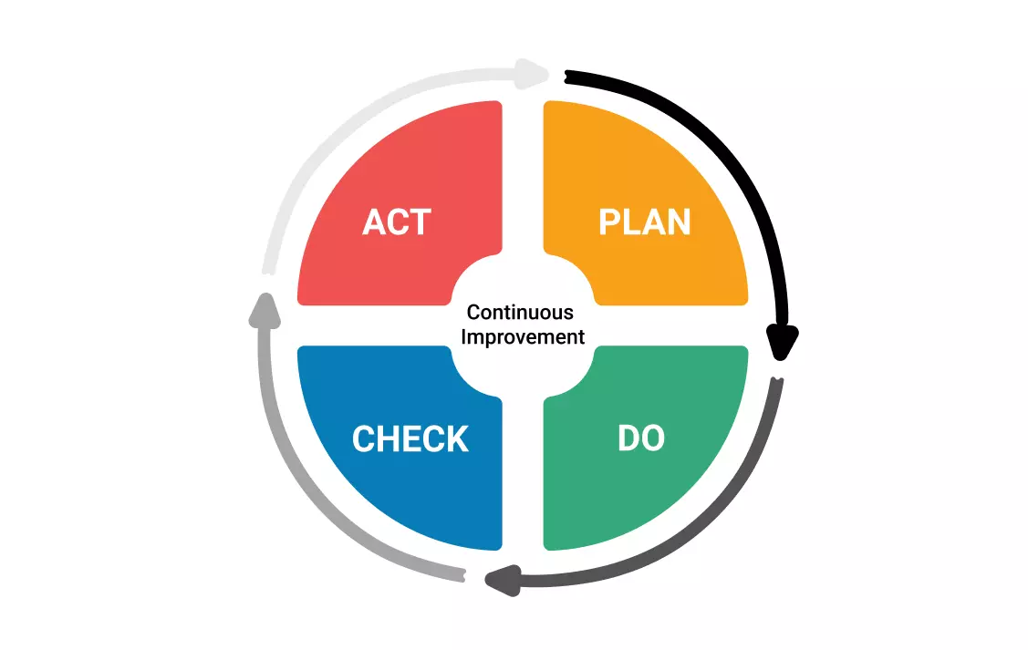
Lesson 2.1 : The Plan Do Check Standardize/Act Cycle- Structured Flow (Step 1)
PDCS - PDCA (Plan-Do-Check-Standardize /Act) is an iterative process with a four-stage systematic approach for continuous improvement in processes and for implementation solutions
The Plan
Self Notes: Module 5- Test

Slide 70
Lesson 2.2 : The Plan Do Check Standardize/Act Cycle- Structured Flow (Step 2)
PDCS - PDCA (Plan-Do-Check-Standardize /Act) is an iterative process with a four-stage systematic approach for continuous improvement in processes and for implementation solutions
The Do- Action
Self Notes: Module 5- Test

Slide 71
Lesson 2.3 : The Plan Do Check Standardize/Act Cycle- Structured Flow (Step 3)
PDCS - PDCA (Plan-Do-Check-Standardize /Act) is an iterative process with a four-stage systematic approach for continuous improvement in processes and for implementation solutions
The Check - is the outcome as per Plan
Self Notes: Module 5- Test

Slide 72
Lesson 2.3 : The Plan Do Check Standardize/Act Cycle- Structured Flow (Step 3)
PDCS - PDCA (Plan-Do-Check-Standardize /Act) is an iterative process with a four-stage systematic approach for continuous improvement in processes and for implementation solutions
Standardize if the check/outcome is as per Plan or repeat the PDCA/S cycle
Self Notes: Module 5- Test

Slide 73
Lesson 2.4 : User Experience & Iterative Process
You have earlier listed down the stakeholder pain points, Goals, and traits & skills. Now with your solution in hand, cross-check at what extent your solutions overcome the pain points, Matches the expectation of their goals and needs, and falls under the boundary of user’s traits and skills. ‘what change we want to bring and what change is actually needed for the user’
Self Notes: Module 5- Test

Slide 74
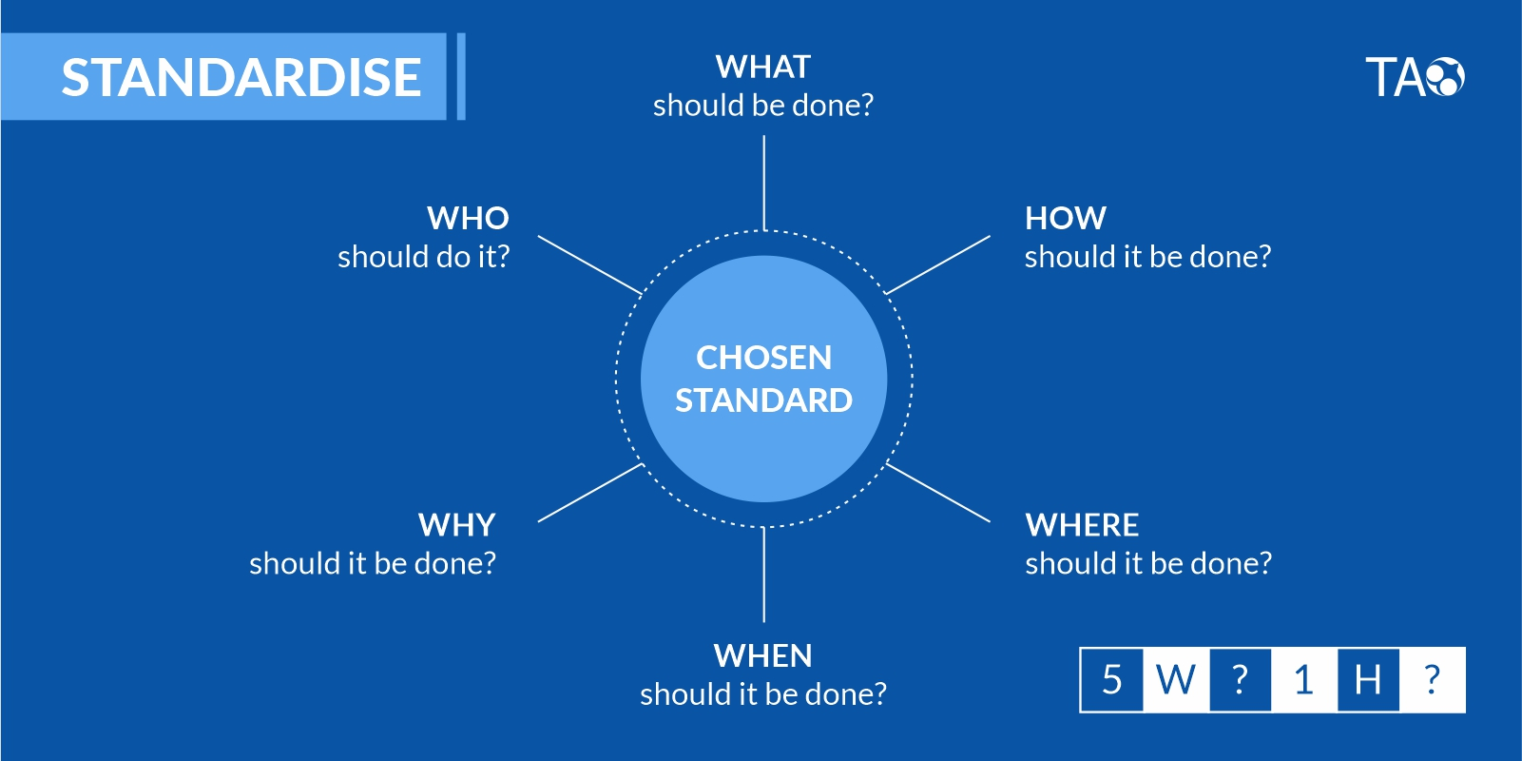
Lesson 3 : The Standardize Cycle
5W1H is a method using in asking questions about a particular problem or a problem taken up for improvement
Self Notes: Module 5- Test

Slide 75
4.0 - Assessment
Self Notes: Module 5- Test

Slide 76
5.0 Reflections & Review
Add your reflections and module review and now you move to the closure of your Social Challenge -Project
Self Notes: Module 5- Test

